Slide 1
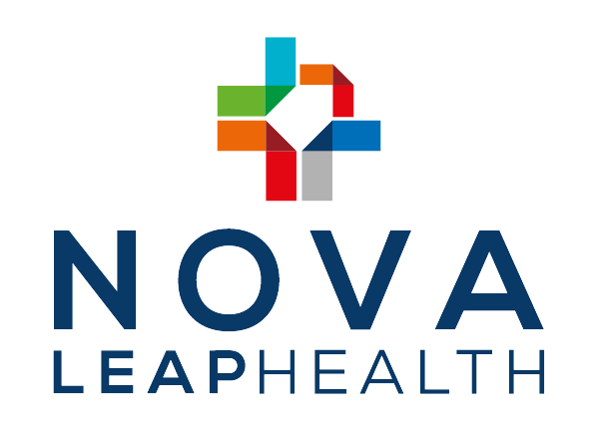
TSXV- NLH (OTCQX:NVLPF)
March 2026 Investor Presentation

Slide 2



Forward Looking Statements
This Nova Leap Health Corp. (“Nova Leap” or the “Company”) presentation contains certain statements, which may constitute “forward- looking information” under Canadian securities law requirements and “forward looking statements” under applicable securities laws (“forward-looking information”). All statements other than statements of historical fact contained in this presentation, including, but not limited to, statements with respect to the future financial position and results of operations, strategy, plans, objectives, goals and targets, may constitute forward looking information. Forward-looking information can be identified by the use of words such as “could”, “expect”, “believe”, “will”, “may”, “intend”, “plan”, “estimate”, “anticipate”, “predict”, “project” and similar expressions and statements relating to matters that are not historical facts.
Forward-looking information involves known and unknown risks and uncertainties and other factors which may cause the actual results, performance or achievements of Nova Leap to be materially different from any future results, performance or achievements expressed or implied by such forward-looking information. These factors include regulatory changes affecting the home care industry; unexpected increases in operating costs; competition from other service providers; and other risks identified in the Company’s continuous disclosure materials filed on SEDAR+.
Forward-looking information is based on assumptions that Nova Leap believes to be reasonable. Key assumptions upon which the Company’s forward-looking information is based include, but are not limited to: assumptions concerning general economic and market conditions, availability of working capital necessary for conducting Nova Leap’s operations, and Nova Leap’s ability to integrate its acquired businesses and maintain previously achieved service hour and revenue levels.
Although the Company has attempted to identify important factors that could cause actual actions, events or results to differ materially from those described in forward-looking information, there may be other factors that cause actions, events or results not to be as anticipated, estimated or intended. There can be no assurance that forward-looking information will prove to be accurate, as actual results and future events could differ materially from those anticipated in such statements. Accordingly, readers should not place undue reliance on forward- looking information. The forward-looking information in this presentation, including any financial outlook or future-oriented financial information, is made as of March 2026 for the purpose of providing information about management’s current expectations and plans relating to the future. The Company undertakes no obligation to publicly update or revise any forward-looking information, whether as a result of new information, future events or otherwise, other than where a duty to update such information or provide further disclosure is imposed by applicable law.

Slide 3





Investment Highlights
Market Leader in an Essential and Growing Industry
Performing a vital role within the continuum of care with an individual and family centered focus, particularly those requiring dementia care
Growth opportunities driven by an aging demographic and a constant pipeline of opportunities in a highly fragmented industry
Impressive History of Rapid Growth and Well-Positioned to Capitalize on a Fragmented Industry
20+ acquisitions completed since 2016 at an average target revenue multiple of 0.5x and target EBITDA multiples in the range of 3.0-5.0
Re-engaged acquisition program in 2024 by completing strategic acquisitions in Massachusetts, Florida and Nova Scotia.
>90% of companies active in the sector are mom and pop shops with the top three players comprising <5% of home care sector revenue
Substantial de novo and acquisition opportunities
Operations span New England, Southeastern, South Central and Midwest regions of the U.S. as well as Nova Scotia, Canada
Strong Financial Performance and Position
Reported record Annual Revenue and Adjusted EBITDA of $31.5M and $2.05M in 2025.
Increasing gross margins demonstrate ongoing pricing power in an inflationary environment.
During 2024, amended existing credit agreement with BMO Bank of Montreal, providing up to $7M of available credit to support long –term growth strategy. As of March 2026, $4.7M is available on facility.
Available cash of USD$1.5M and full access to revolving credit facility of CAD$1.5M as the end of 2025.
Total bank debt and promissory notes of $2.1M at the end of 2025, representing a leverage ratio of 1.02 times 2025 adjusted EBITDA.
Aligned Management Team with History of Execution
Management has repeatedly demonstrated ability to identify, negotiate and close on acquisitions favorable to shareholders
Insider ownership of > 42% creates alignment with external shareholders
Investment Opportunity
The Company welcomes discussions with investors who view Nova Leap as an attractive long-term investment opportunity.

Slide 4


What is Non-Medical and Skilled Home Care?
Nova Leap is focused on acquiring and organically growing Home Care Companies
Non-Medical Home Care | Home Health Care
What is home care? Home Care is about sustaining and maintaining your loved one’s quality of life in their home – keeping them safe and comfortable | What is home health care? Home healthcare is skilled care to help someone get healthy while at home. It comes after a doctor’s visit or a hospital stay and is provided by medical professionals
What do you get from home care? Dementia care; Personal grooming like bathing or getting dressed; Moving around: getting in and out of the bed/shower; Medication reminders; Errands like grocery shopping and picking up prescriptions; Light housekeeping; and Meal preparation | What do you get from home health care? Skilled nursing; At-home physical therapy; Pain management; Caring for wounds; and Prescription management G-Tubes Blood Draws Insulin Injections
Who pays for home care? Out-of-pocket (no reimbursement risk) | Who pays for home health care? Government payor (reimbursement risk)

Slide 5
Home Care Industry Overview
Home care is one of the fastest growing healthcare industries in the United States and directly benefits from the growing size of the aging population.
An aging population, the prevalence of chronic disease, growing physician acceptance of home care, medical advancements and a movement toward cost-efficient treatment options from public and private payers have all fostered industry growth.
Industry Outlook
The total at-home care industry is projected to grow at a CAGR of 4.9% between 2020 and 2026⁽¹⁾
Total At-Home Care Services
The non-medical home care industry represents 6.4% of U.S. total at-home care⁽¹⁾

Slide 6
Industry Growth Drivers
U.S. Population with Alzheimer’s⁽¹⁾
Increasingly aging population
By 2030, over 1 in 5 Americans is expected to be over the age of 65.
Increasing prevalence of dementia amongst North Americans as seniors age to 75+
Dementia patients currently account for ~70% of Nova Leap’s revenue.
Expected reduction in caregiver alternatives
Currently, most competition stems from family members opting to treat their seniors themselves, rather than seeking assistance.
The PHI (U.S. home care advocacy group) estimates that insourced home care is likely to be less frequent due to socioeconomic factors including:
increased female participation in the workforce;
unwillingness to make necessary sacrifices; and
inability of spouses to provide care as they age as well.
1
Ages 65 - 74
Ages 75 - 84
Ages 85+
2
3
U.S. Population Greater than 65⁽²⁾
Population >65 (MM)
% of total population

Slide 7
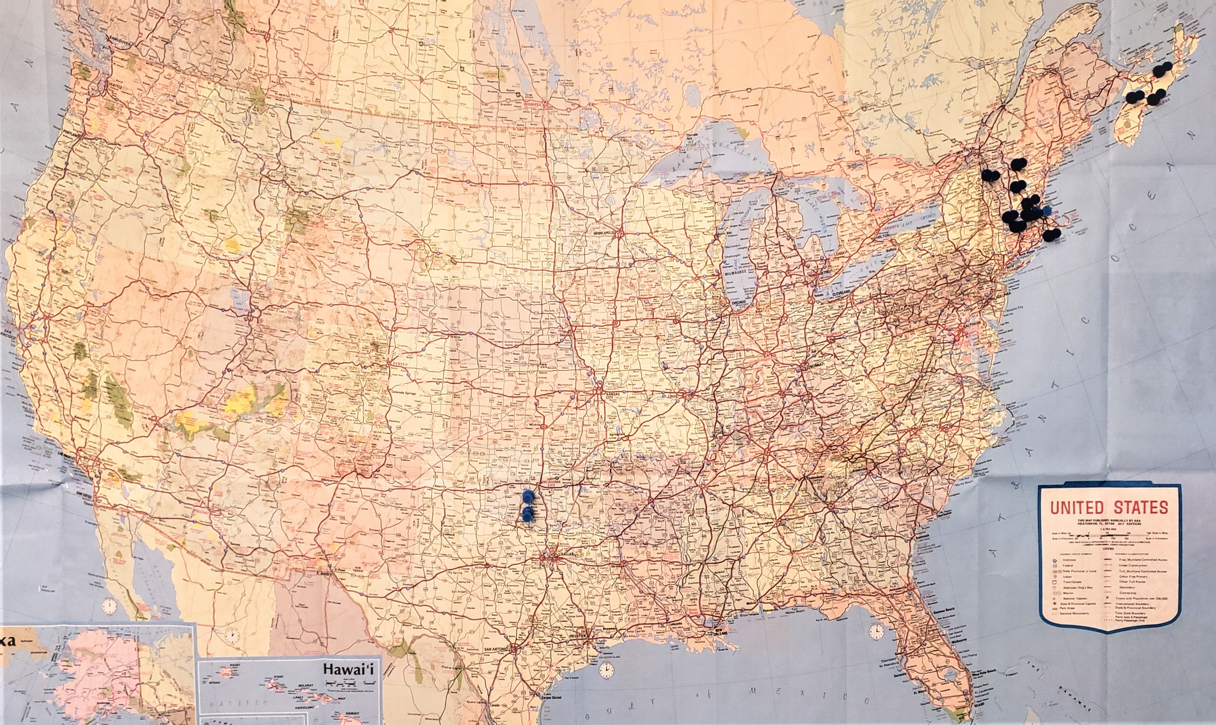

Nova Leap’s Office Map – Enormous Potential
from Where We Are….to Where We Plan to Grow
Driven by Demographics and Accretive Opportunities with Good Track Records
We look to expand opportunistically across regions and deepen our presence in our existing operating areas
Ability to Scale by Operating Decentralized, Local Management Combined with Centralized Head/Back Office Support
Optimized cost structure with local expertise will lead to enhanced margin profile
We look for acquisition targets that have strong people and culture

Slide 8
Landscape Primed for Consolidation
The home care providers industry is highly fragmented, with more than 90% of the industry consisting of mom-and-pop shops
The three largest companies generate less than 5% of industry revenue
Government reform and cuts to Medicare and Medicaid threaten industry profits thereby encouraging consolidation
Target Acquisition Criteria
U.S. and Canada geographic focus Positive EBITDA with strong reputation/brand 5+ year operating history Opportunities for operational synergies $1M - $25M of Revenue
Nova Leap identifies acquisition opportunities that can provide
meaningful revenue and EBITDA contribution at accretive purchase multiples

Slide 9



Growth Strategy
1
2
3
Organic Growth
De Novo expansion for deeper penetration into existing geographical markets.
Acquisitions
Primary focus - acquire home care companies in states and provinces, with a focus on existing and complimentary markets. Secondary focus - gain footholds in new geographies through acquisition
Service Line Expansion
Broadening of services lines into a multi-line community care organization with the recent expansions into care management and palliative care.
Aging demographic growth trends support Nova Leap’s expansion plans

Slide 10
Financial Profile
Nova Leap has an impressive history of rapid and consistent revenue and Adjusted EBITDA growth
Annual Revenue (US$ MM)
Quarterly Revenue (US$ MM)
Annual Adjusted EBITDA (US$ MM)
Quarterly Adjusted EBITDA (US$ MM)

Slide 11
Management Team
Corporate Management Team
Chris Dobbin, CPA, CA, ICD.D President, CEO & Director | Founding President & CEO of Nova Leap Health Corp., and previous Co-Owner of Earth Angels Home Care. Recognized as one of Atlantic Canada's Emerging Leaders, EY Entrepreneur of the Year® 2019, Director at Medavie Inc. and NL2 Capital Inc.
Chris LeBlanc, CPA, CA CFO & Corporate Secretary | Responsible for implementing business process improvements in the accounting, finance, reporting and budgeting function. Twenty years of progressive experience, including a publicly traded mid-tier international mining company and a large private equity owned environmental and industrial cleaning company.
Melissa Anderson Senior Vice-President Nova Leap Home Health | Direction and oversight of operations of all US based agencies. Twenty-five years of home care and hospice experience, including extensive experience operating and managing home care agencies.
Jill Dobbin, MSc President Earth Angels Home Care | Responsibility for Canadian Operations. Previous Co-Owner of Earth Angels Home Care with over a decade of direct experience managing and growing multi-site home care operations.
Breanne Muchemore, MSW, LICSW, CCM VP, Nova Leap Care Management | Responsibility for U.S. care management division. Nationally respected care management leader with nearly two decades of clinical and care management experience.

Slide 12
Board of Directors
Board Directors
Dana Hatfield CPA, CA Independent Director | Co-founding shareholder of Nova Leap Health Corp., Chair of the Board CFO and former director of GoGold Resources Inc. (TSX:GGD), a Canadian company producing silver and gold in Mexico Over 25 years of experience in financial leadership roles including CFO for Brigus Gold Corp. and Director of Finance with the Eastern Canada division of Sysco Corporation
Michael O’Keefe MBA, CPA, CMA Independent Director | Co-founding shareholder of Nova Leap Health Corp., Chair of the Audit Committee Executive advisor, a founding director and former CFO of Aqualitas Inc., a licensed aquaponics cultivation company Previously served as CFO at Morien Resources Corp. (TSXV:MOX) a junior royalty company, and as Director of Finance at Erdene Resource Development Corp. (TSX:ERD), a junior exploration company focused on Mongolia
Wayne Myles K.C. Independent Director | Chair of the Nominating Committee Director of Torrent Capital, an investment company and merchant bank focused on Canadian small cap equities. Past Chairman of Newfoundland Labrador Liquor Corporation and Past Chairman of the Board of Victoria Order of Nursing (VON) Canada
Marie Mullally MBA, FCPA, ICD.D Independent Director | President & CEO of CUA, one of Atlantic Canada’s largest community banking institutions Former Chair of the Halifax International Airport Authority Recognized as one of the top 50 CEOs in Atlantic Canada Awarded Fellow Chartered Accountant designation from the Institute of Chartered Accountants of Nova Scotia and was named Chartered Accountant of the Year in 2008.
Anne Whelan, MBA, ICD.D Independent Director | Founder and CEO of Seafair group, owner of home care operations in Canada and previously in the U.S. Director of the Bank of Canada and of CSA Group (Canadian Standards), and previously chaired the board of Newfoundland Power Recognized as CEO of the Year in Atlantic Canada (2014), one of Canada’s Top 100 Most Powerful Women (2016) and Startup Canada’s Entrepreneur of the Year (2018). 2012 Queen’s Diamond Jubilee recipient for contributions to home care.
Chris Dobbin, CPA, CA, ICD.D President, CEO & Director | Founding President & CEO of Nova Leap Health Corp., and previous Co-Owner of Earth Angels Home Care Recognized as one of Atlantic Canada's Emerging Leaders, EY Entrepreneur of the Year® 2019, Director at Medavie Inc. and NL2 Capital Inc.

Slide 13
Corporate & Capital Structure
Summary of Capital Structure
Equity summary
Shares Outstanding (basic) | 87,314,252
Options Outstanding | 8,225,000
DSUs Outstanding | 500,000
Fully Diluted | 96,039,252
Share price (as of March 6, 2026) | C$0.345
ITM Market Capitalization ($ MM) | C$30 / US$22
Insider Ownership (non-diluted): | 42.4%
Capital Markets Performance
LTM Share Price Performance
Share Price (C$)
Mar 2025 May 2025 Aug 2025 Nov 2025 Jan 2025 Mar 2026

Slide 14
NLH - TSX V
CHRIS DOBBIN, CPA, CA, ICD.D
cdobbin@novaleaphealth.com

